Slide 1
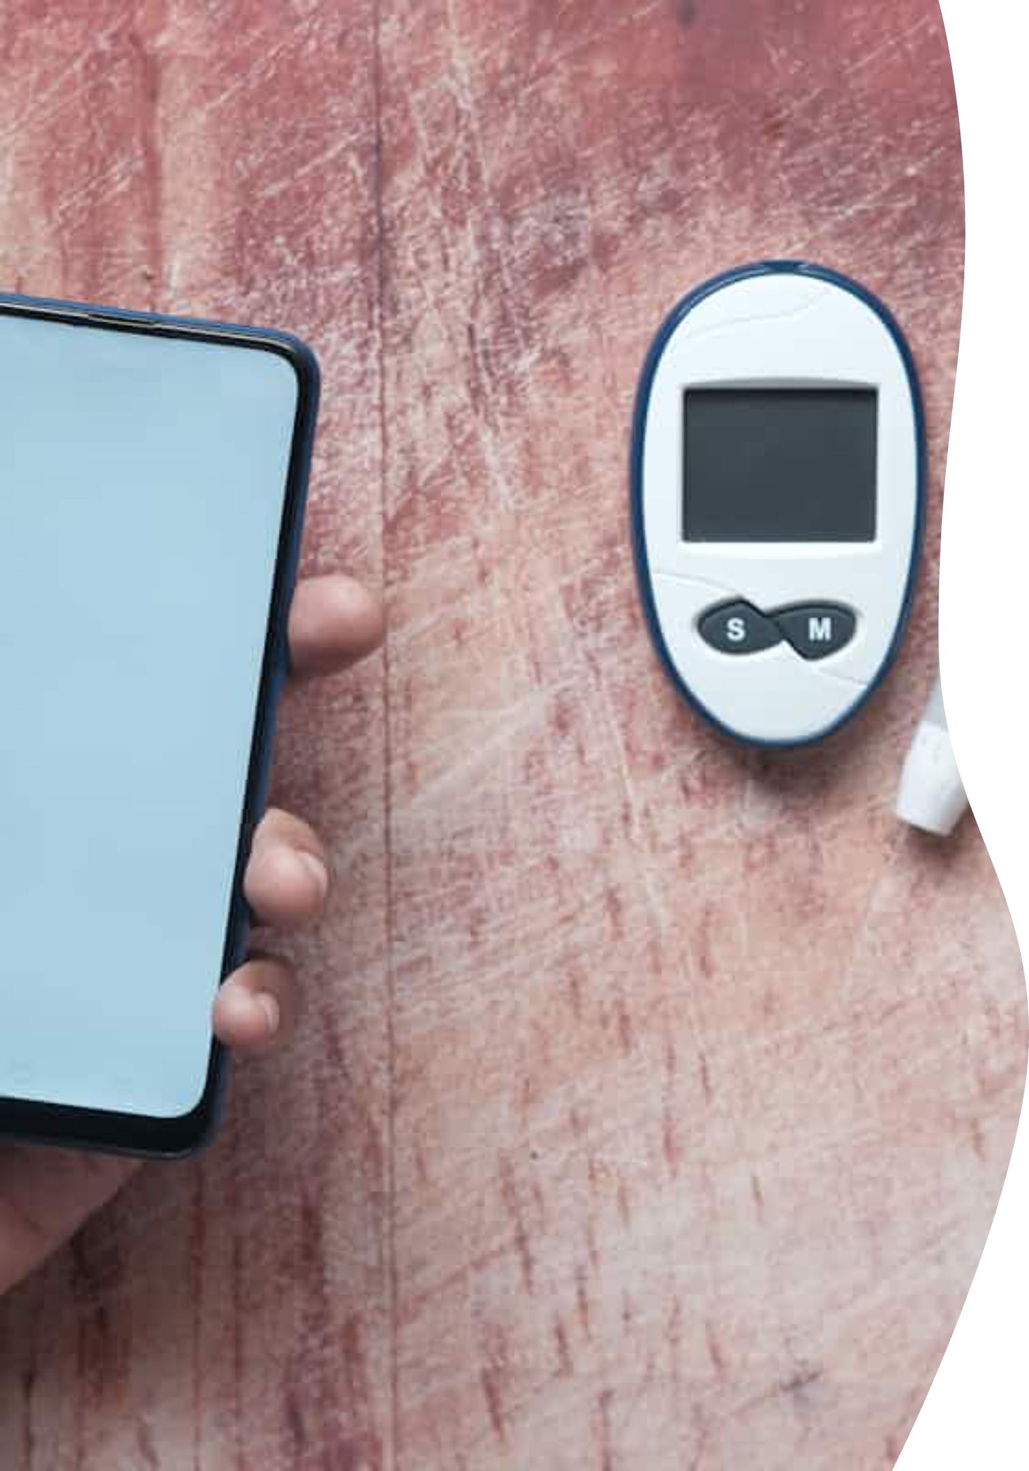
Understanding Diabetes: A Complete Guide
Empowering patients through education and innovative technology

Slide 2
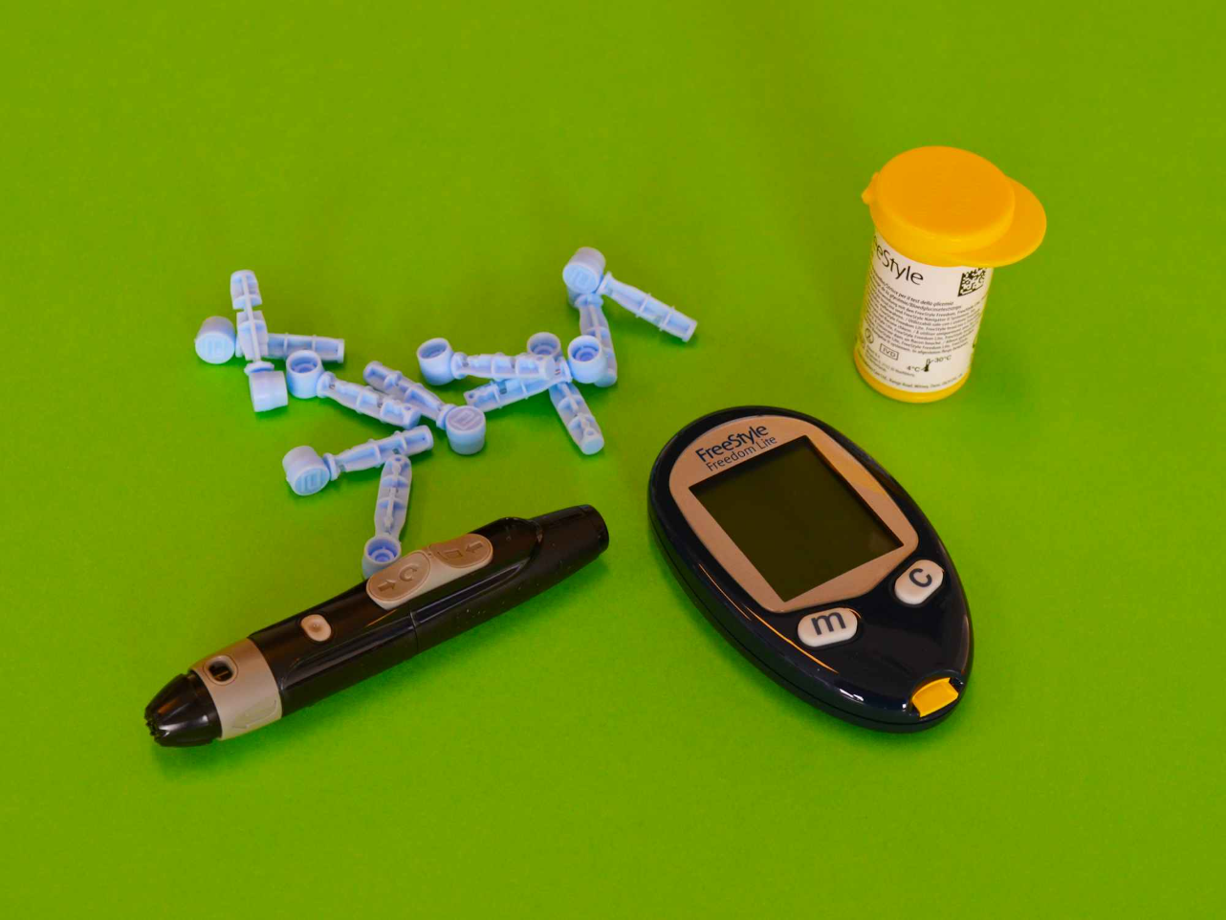
What is Diabetes?
The Basics
A chronic condition where blood glucose levels remain consistently elevated
Body cannot produce or properly use insulin
Affects 422+ million people globally
Leading cause of blindness, kidney failure

Slide 3
The Insulin Connection
01
02
Food Consumption
Glucose Release
Carbohydrates break down into glucose
Blood sugar levels begin to rise
03
04
Insulin Response
Cellular Uptake
Pancreas releases insulin hormone
Cells absorb glucose for energy

Slide 4
Type 1 vs Type 2: Key Differences
Type 1 Diabetes
Type 2 Diabetes
Autoimmune condition
Insulin resistance develops
Usually diagnosed in childhood
Often diagnosed in adulthood
No insulin production
Reduced insulin effectiveness
5-10% of all cases
90-95% of all cases

Slide 5
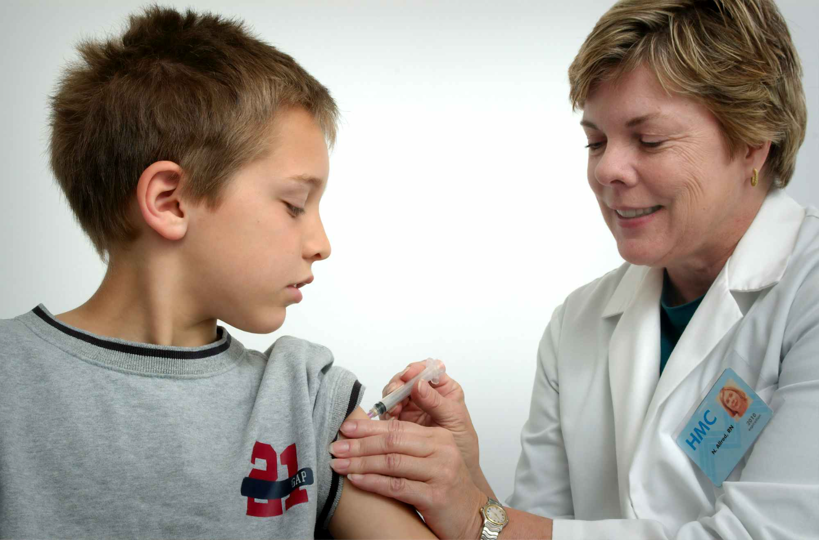
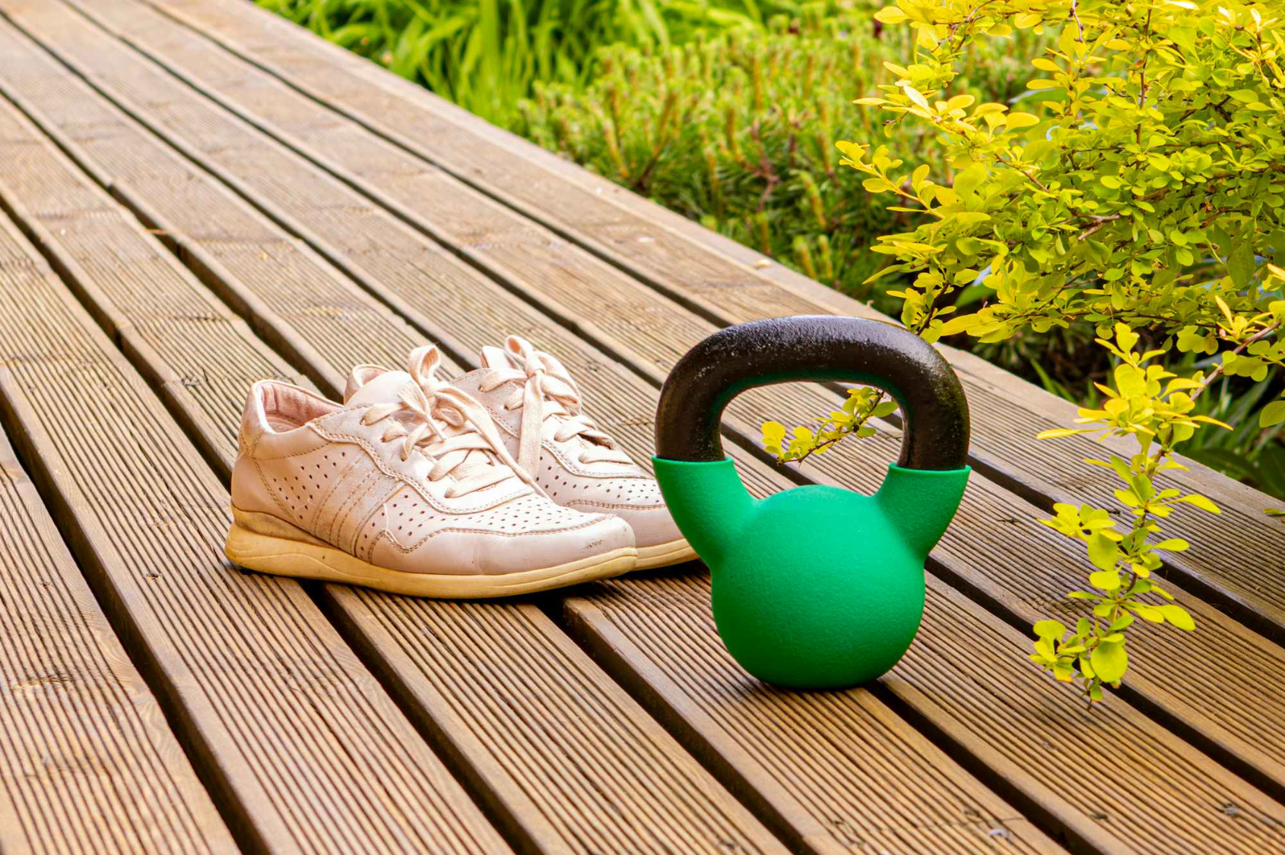
Risk Factors & Causes
Type 1
Type 2
Genetic predisposition
Obesity and inactivity
Environmental triggers
Family history
Viral infections
Age over 45
Not preventable
Often preventable

Slide 6
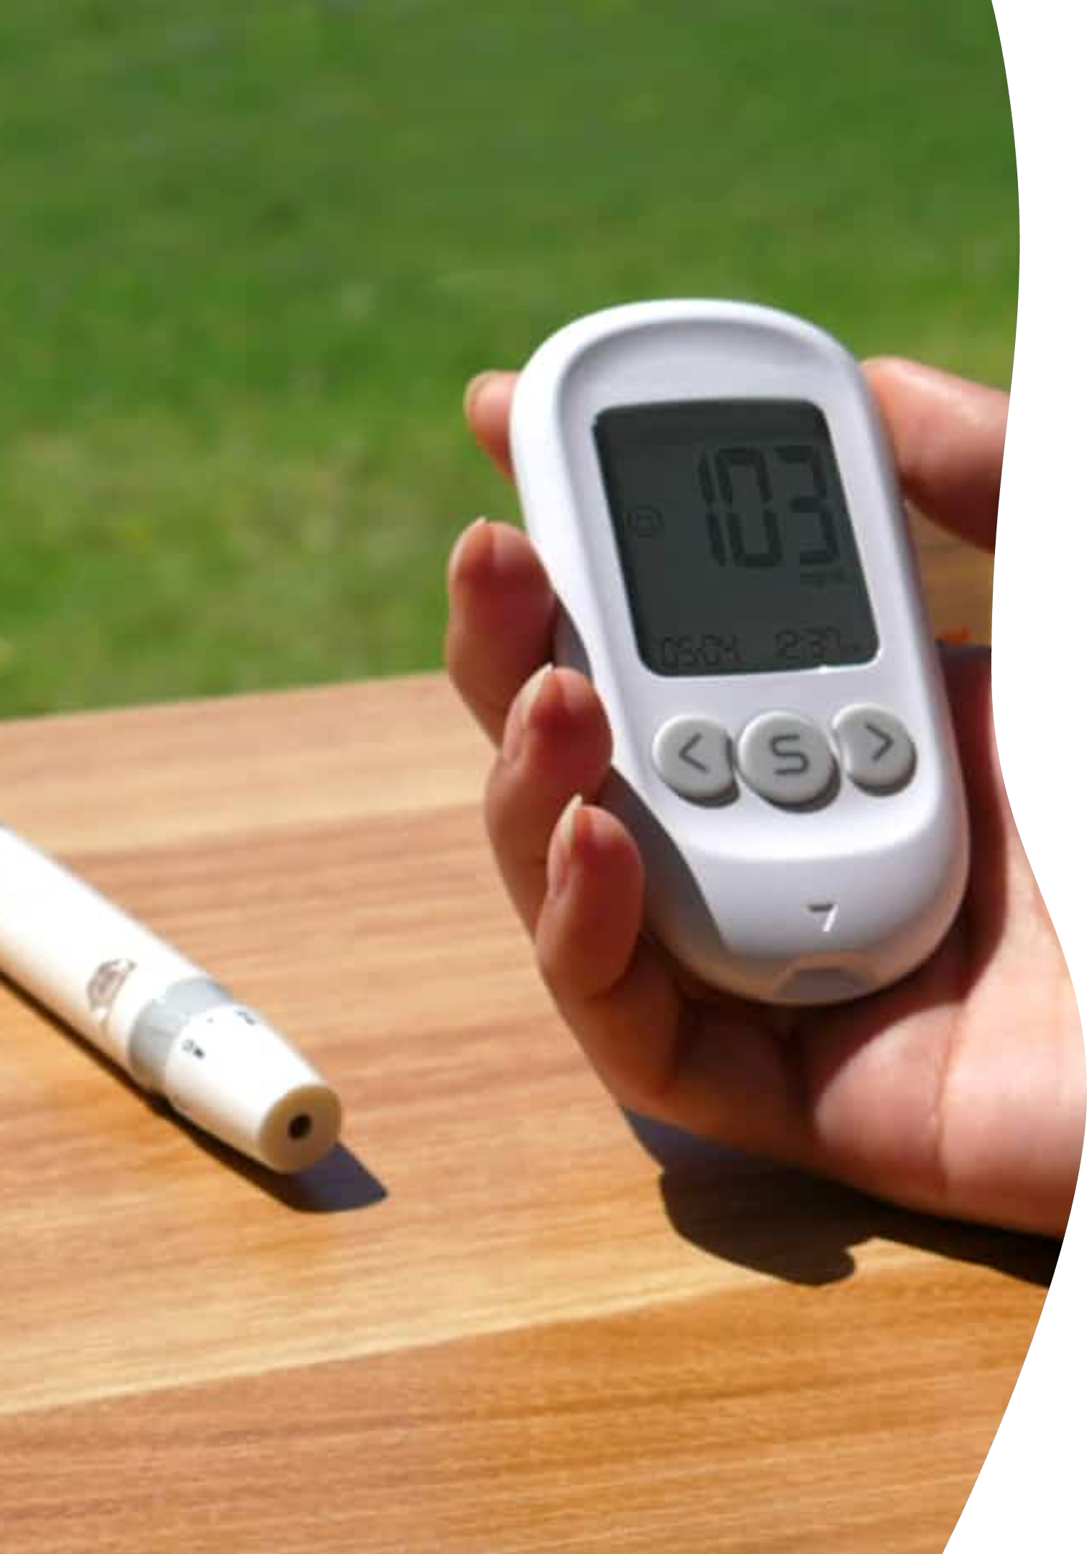
Daily Management Challenges
Carb Counting Complexity
Insulin Dosing Precision
Estimating carbohydrates in meals requires extensive knowledge and experience
Incorrect calculations can lead to dangerous blood sugar swings
Lifestyle Limitations
Constant monitoring affects social dining and spontaneous activities

Slide 7
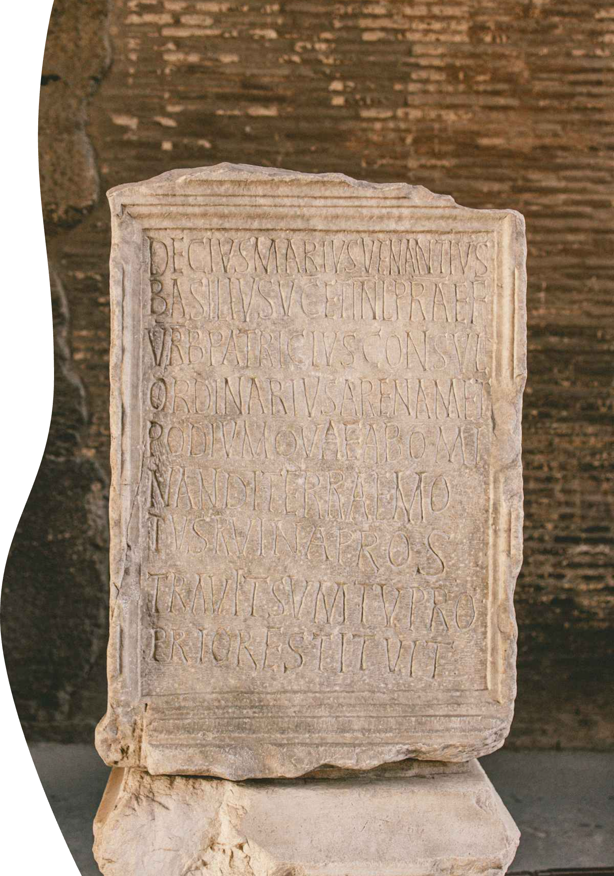
How to solve the issue
Slavery

Slide 8
Thinking Outside the Box
Sometimes, tackling a challenge requires a slightly controversial strategy to get things done:
1. Find an issue
Identify a problem that demands an innovative solution.
2. Find a random developer on the web
Tap into the global network of talent for expert assistance. (never pay them)
3. Make them work for you
Effectively delegate and guide them to implement your vision. (make them do all the job)

Slide 9
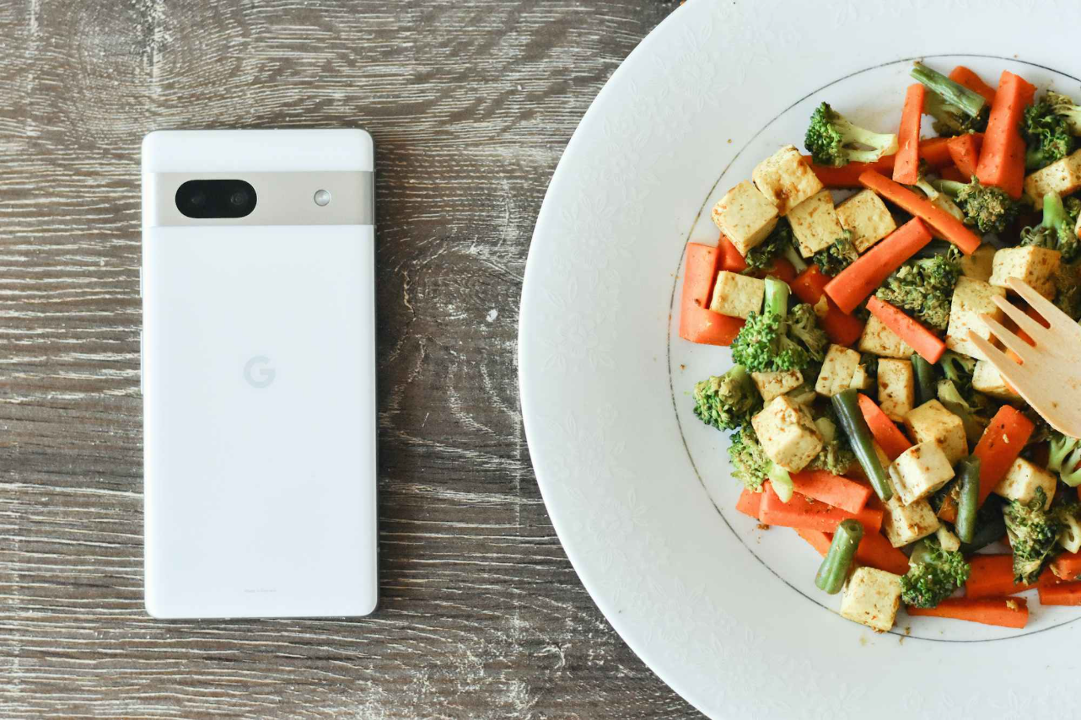
Introducing: Smart Nutrition AI
Revolutionary Meal Analysis
Snap a photo or scan a QR code
Instantly receive:
Precise carb content
Total calories
Portion weight
Suggested insulin dosing

Slide 10
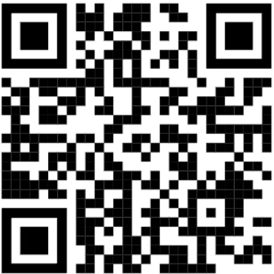

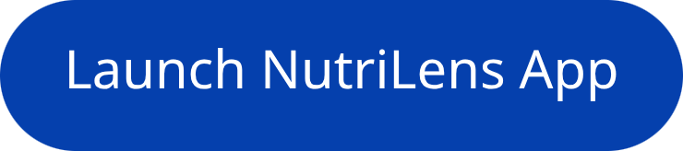
How It Works
Experience the power of Smart Nutrition AI firsthand. Explore our demo and the live application to see how seamless diabetes management can be.
View the mobile experience
Try the Demo Application
See how our app interacts with your phone in real-time
Dive into the NutriLens app and discover its intuitive features for precise nutrition analysis.

Slide 11
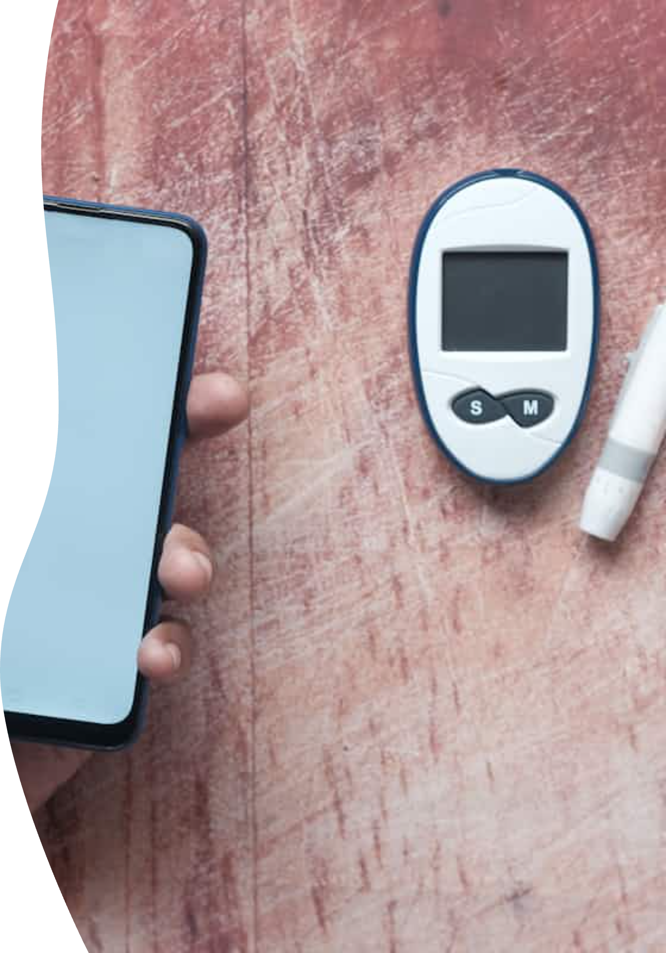



How It Works
Capture
Photo or QR scan of your meal
Analyze
AI processes nutritional content
Calculate
Personalized insulin recommendations

Slide 12



Key Benefits
95% Accuracy
Instant Results
Food Freedom
Clinically validated nutritional analysis (by myself)
Analysis completed in under 3 seconds
Eat confidently anywhere, anytime
Transforming diabetes management from guesswork to precision

Slide 13
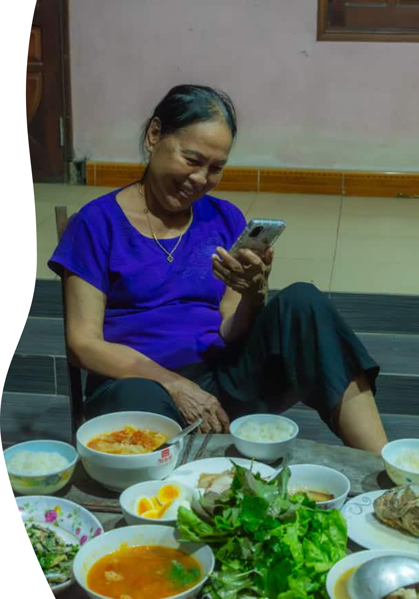



Empowering Better Health
Smart Nutrition AI bridges the gap between complex medical needs and everyday life
Reduces management stress
Improves glucose control
Enhances quality of life

